Slide 1
Linux Essentials
INTERNAL

Slide 2
Welcome to Linux Essentials
INTERNAL

Slide 3
Introduction to Linux
INTERNAL
Linux Essentials
Introduction to Files and File Systems
Utilities
Shell scripting and vi editor Diagnostics and Monitoring
Packages and Installations

Slide 4
Module-0
Pre-Requisites
INTERNAL

Slide 5
INTERNAL
Need your attention
Create your own space and work on your own space
While working on server do not step into others Directory
Please use all commands cautiously. Unless asked to, do not use rm / rmdir etc. Commands as it may cause Damage to others sessions.
5

Slide 6
Module-1 Introduction to Linux
INTERNAL

Slide 7



What is an Operating System ?
INTERNAL
A software which will
Manage all parts of the system
Keeps track of all components of a system and ensure correct usage
Acts as sort of shield or layer which hides the complexity of the underlying hardware,
Presents a simplified interface
End user app
OPERATING SYSTEM
HARDWARE CPU,,MEMORY,HD
OS Types
Desktop Systems
example DOS
Distributed Operating Systems Windows, Novell
Multiprogramming Operating System - UNIX

Slide 8
UNIX OS
INTERNAL
It is Multi-user, multi-tasking centralized Operating System
Host
Uses time slice to manage multiple tasks
OS runs in a host and users connect to this host using a terminal
Unix terminals are “dumb terminals”
terminal
Terminal Emulators like putty are used to connect to Unix HOST from PC/Laptops

Slide 9
Origin of UNIX Operating System
INTERNAL
UNIX has evolved over the past many years, from its conceptual state into a powerful and effective OS
UNIX evolved from a early time-sharing OS called MULTICS.
Ken Thompson, Dennis Ritchie etc of AT&T of Bell Laboratories are key contributors of UNIX OS design in early 70’s
Originally written in assembly language, the core of the UNIX system was recoded in ‘C’ in 1973,after Dennis Ritchie came up with ‘C’ language
In 1977, Berkeley campus of the University of California made the first BSD release
Ideas and code from Berkeley Unix (including the vi(1) editor) were fed back to Bell Labs
First Commercial Release – 1980’s as AT&T System V UNIX ,followed by SCO, Sun Microsystems,IBM etc.

Slide 10







Unix and Linux
INTERNAL
In August 1991 Linus Torvalds, then an university student from Finland, announced the Linux project as part of Free Software Foundation (FSF)
Objective was to write an OS similar to MINIX.
Initial Kernel was free under Open Software License.
Linux distributions are both Open Source and Commercial

Slide 11
Unix Vs Linux
INTERNAL
Unix is considered as legacy now a days
Unix OS came in their own boxes – Non portable
Cannot dual boot
Do not understand Windows partitions
A few key differences in kernel like streams, threading etc.
Linux are UNIX like

Slide 12
Features of *NIX OS
INTERNAL
Multi-user, Time-sharing OS
Multi-tasking OS
Portable
Modular
Secure
Efficient tools
Strong text processing capability
Simple
Text files for storing data
Everything is a file – devices , terminals , memory

Slide 13
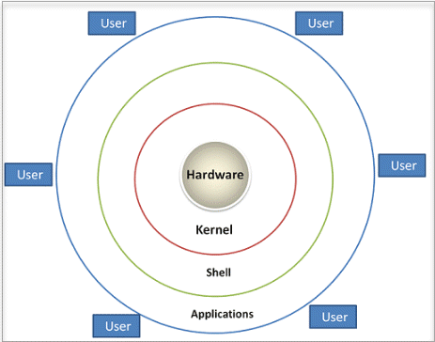
UNIX / Linux Architecture
INTERNAL
Kernel :Responsible for all the major activities of the LINUX operating
Shell : Command utility programs which runs on Shell interpreter

Slide 14
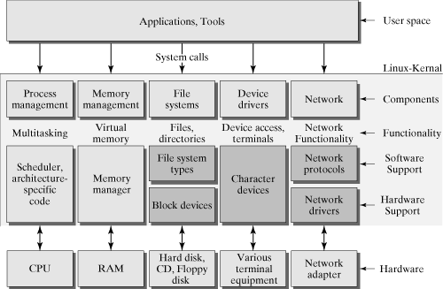
Operating System Architecture
INTERNAL

Slide 15
Starting a session
INTERNAL
Users must always be authenticated to use system resources on UNIX
Getty is the program that enables one to log in through a serial device such as a virtual terminal, a text terminal, or a modem
Once username is entered , getty hands this over to login program which asks for a password,
Login checks user details in /etc/passwd file and passwords in /etc/shadow
Once the authentication is completed starts a shell, which displays a prompt
Logging out with exit or ctrl+d

Slide 16
Module-2 File Systems
INTERNAL

Slide 17
File System
INTERNAL
File Systems
A way to organize data in the storage medium – storage and retrieval
Specific to Operating Systems - DOS had FAT, Windows has NTFS etc.
*nix File Systems
*nix looks at all disks and storage devices as part of one filesystem
The top of the filesystem is called the "root" directory and is represented by the forward slash /.
Each directory, starting with the root directory needs to have a storage device associated with it. ---A whole disk, or just a partition of the disk
Any subdirectories that are created will use the storage space assigned to their parent directory, unless they are assigned their own storage space.(for example /usr , /proc etc)
Multiple Filesystems are supported
Storage area can have different Filesystems and can be “added” to the tree structure
The directory is a special file which contains the name/inode pair mapping for files “contained”
in the directory
The root directory “contains” all the other directories.
17

Slide 18
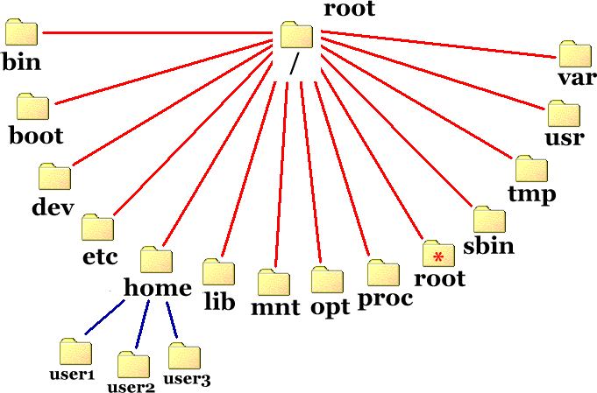
File System hierarchy
INTERNAL
Contains binary executables, Common linux commands
Primary hierarchy root and root directory of the entire file system hierarchy.
Variable Data
Files
Secondary hierarchy for read-only user data; contains the majority of (multi-)user utilities and applications.
Kernel initrd, vmlinux, grub files are located under /boot
terminal devices, usb, or any device attached to the system.
Temporary files. Often not preserved between system reboots, and may be severely size restricted.
Host-specific system-wide configuration files
Libraries essential for the
Optional application software packages.
Users’ home directories, containing
saved files, personal settings, etc.
binaries
Temporarily
Essential system binaries, e.g., fsck, init, route.
in /bin/ and
/sbin/
mounted
filesystems
Document Title
18

Slide 19
Files in Unix
INTERNAL
Ordinary Files
text, executable programs, images, etc.
Directories
Branching points in the hierarchical tree
Used to organize groups of files
May contain ordinary files, special files or other directories
Special Files
Used to represent a real physical device such as a printer, tape drive or terminal, used for Input/Output (I/O) operations
Two types of I/O: character and block
Usually only found under directories named /dev
Symbolic link file
A special file which points to another file
Pipes
UNIX allows commands to be linked together using a pipe. The pipe acts a temporary file which only exists to hold data from one command until it is read by another
For process communication
Document Title
19

Slide 20
Common File System commands
INTERNAL
Command |  | Description |  | Command
cp |  | To copy files from source to destination |  | cp <source> <destination>
mkdir |  | To create a directory |  | mkdir <directory>
rmdir |  | To delete a directory, provided the directory is em |  | rmdir <directory>
mv |  | rename file |  | mv <source> <newname>
 |  | To move file |  | mv <source> <destination directory>
cd |  | To change directory |  | cd <directorypath>
 |  | To come back to HOME directory |  | cd
rm |  | delete files |  | rm <file>
cat |  | View file content |  | cat <filename>
ls |  | listing the content of directory |  | ls <option> <directory>
file |  | Type of flle |  | file <filename>
find | To search a file |  | find <path> -name <file name> -type <filetype> <operation> find / -name "*.java" -type f -print find -name "*.java" -type f -exec cat {} \ ;
ln | create a hard link |  | ln <file1> <file2>
ln -s | creates a soft link |  | ln -s <file1> <file2>
Document Title
20

Slide 21
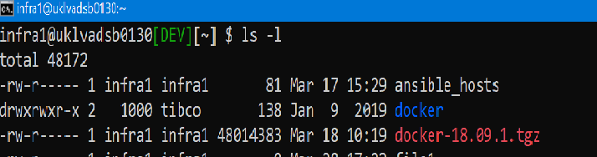
File Access Permission
INTERNAL
Each file and directory in the system has access permissions
read
allows a user to view the contents of a file
Read permission for a directory allows a user to view the contents of a directory.
To view the contents of files in the directory the respective files
must have read permission
write
A user who has write permission on a file can change the contents of a file
Write permission on a directory allows a user to change the
contents of a directory.
The user may add files or delete existing files.
Changing the contents of a file in the directory depends on write permissions for respective files
execute
allows a user to use the filename as a system command.
On a directory it allows the user ‘search’ permissions on the
directory.
The user can copy files into the directory
ls –l will give a detailed list of permissions for each entry in the directory
Document Title
21

Slide 22
Changing permission
INTERNAL
The chmod command is used to change the file modes of the specified files and directories
File permissions can be changed only by the owner.
File access permissions can be changed in two ways
using the symbolic mode
Who is affected, the operator indicating action taken, and the permission. chmod [ugo] [+/-] [rwx] [filename]
or the absolute mode
In the absolute mode octal numbers are used to represent the three kinds of access permissions.
The octal values are: 4 (read,2 write,1 execute)
 | User | Group | Others
Read | 4 | 4 | 4
Write | 2 | 2 | 2
Execute | 1 | 1 | 1
chmod 760 abc chmod uo +x ac
umask – set permissions globally
With umask one can specify the default permission for files
umask takes a number nnn which indicates what to subtract from the full permission value 777. Umask 022 indicates 0,2,2 to be subtracted from 7,7,7, thus the default permission of the file would be
rwx,r-x,r-x
Document Title
22

Slide 23
Compressing the file
INTERNAL
tar
command for archiving and unarchiving files and as well as directories.
A .tar file is not a compressed file
it is actually a collection of files within a single file uncompressed.
tar -cvxf archive_name file1 file2 ...
gzip
Compresses regular files (ignores symbolic link)
By default, gzip keeps the original file name and timestamp in the compressed file.
Compressed files can be decompressed using gzip –d , gunzip or zcat
23

Slide 24
Module-2 Utilities
INTERNAL

Slide 25
What is Utility
INTERNAL
Unix utilities are “programs” which performs a specific task like sorting, reversing etc.
Commands work as follows:
Accept some data as input.
Perform some manipulation on the inputted data.
Produce some output.
Standard devices are the source for input/output and error
Redirections can be used to make the tools perform i/o from other sources like files
Tools can be combined together to perform complex tasks
$ head -1 This is sample This is sample
$ head -1 < sampledata.csv region,uniprice,total
$

Slide 26
Common Utilities
INTERNAL
head
The head command, ,will display the first N lines from beginning a file, default being 10.:
$head -5 employee
tail
The head command, ,will display the first N from end of file, default being 10.:
$tail -5 employee
more
Displays the content of a file with pagination, more ore less supports forward move only
$more /etc/passwd
less
Does the same thing as more but supports scrolling up and down,
$less /etc/passwd

Slide 27
Common Utilities
INTERNAL
The cut command retrieves selected fields from a file.
Options :
-c : selects columns specified by list
-f : selects fields specified by list
-d : field delimiter (default is tab)
$ cut –d: -f2 /etc/passwd
The sort command is useful to sort file in ascending order. Options are:
-r : Reverse order
-n : Numeric sort
-f : Omit the difference between Upper and lower case alphabets
-t : Specify delimiter (default is space)
-k : to specify fields as primary or secondary key
$sort –t”,” -k2n /etc/passwd
$tee user.txt > employee
Standard Input
Standard Output
To display contents of file employee on screen as well as save it in the file:
Output file

Slide 28
Common Utilities
INTERNAL
uniq command fetches only one copy of redundant records and writes the same to standard output.
–u option: It selects only non-repeated lines.
–d option: It selects only one copy of repeated line.
-c option: It gives a count of occurrences.
grep family of command is used for searching lines matching a regular expression
Options of grep:
c : It displays count of lines which match the pattern.
n : It displays lines with the number of the line in the text file which match the pattern.
v : It displays all lines which do not match pattern. i : It ignores case while matching pattern.
-w : It forces grep to select only those lines containing matches that form whole words
$ cut –d: -f2 /etc/passwd | sort | uniq
$ grep –w “Alice” samplefile.txt
$grep –n “Alice” samplefile.txt
Document Title
28

Slide 29
Common Utilities
INTERNAL
Since most of the tools are designed to
take inputs from standard devices and
give output to standard devices, it Is possible to “Pipe” the commands
$ cut d”,” –f1,2 /etc/passwd | sort –t”,” –k1n
Piping means output of one command can become the input to the next.
Achieved through special files called “pipes”
Using a concept of piping, complex tasks can be achieved.
Too many piping can also cause
performance overhead, hence it is better to explore the options first

Slide 30
Regular Expressions
INTERNAL
Expression | Description
^ (Caret) | match expression at the start of a line, as in ^A.
$ (Question) | match expression at the end of a line, as in A$.
\ (Back Slash) | turn off the special meaning of the next character, as in \^.
[ ] (Brackets) | match any one of the enclosed characters, as in [aeiou]. Use Hyphen "-" for a range, as in [0-9].
[^ ] | match any one character except those enclosed in [ ], as in [^0-9].
. (Period) | match a single character of any value, except end of line.
* (Asterisk) | match zero or more of the preceding character or expression.
\{x,y\} | match x to y occurrences of the preceding.
\{x\} | match exactly x occurrences of the preceding.
\{x,\} | match x or more occurrences of the preceding.
Example | Description
grep “smile“ files | search files for lines with ‘smile’
grep '^smile' files | 'smile' at the start of a line
grep 'smile$' files | 'smile' at the end of a line
grep '^smile$' files | lines containing only 'smile'
grep '\^s' files | lines starting with '^s', "\" escapes the ^
grep '[Ss]mile' files | search for ‘Smile' or 'smile'
grep '^$' files | search for blank lines
grep '[0-9][0-9]' file | search for pairs of numeric digits

Slide 31
Lab (File System and utilities)
INTERNAL

Slide 32
Module 4
vi and Shell Scripts
INTERNAL

Slide 33
Overview – vi editor
INTERNAL
10 Reasons to use Vi
Vi text editor is the most popular editor in Linux family
Classic text editor across different platforms and distribution
Does not require graphical interface
Command
Mode
:w :wq :q :q!
4. Always available - Barely booted system in single user mode will have it
Escape
Model
Insert
Mode
5. Uses less amount of system resources
Insert mode:
This mode is for inserting text in the file.
You can switch to the Insert mode from the command mode by pressing 'i' on the keyboard
Once you are in Insert mode, any key would be taken as an input for the file on which you are currently working.
To return to the command mode and save the changes you have made you need to press the Esc ke
Command mode:
The vi editor opens in this mode, and it only understands commands
In this mode, you can, move the cursor and cut, copy, paste the text
This mode also saves the changes you have made to the file
Commands are case sensitive. You should use the right letter case.
6. Run shell commands without leaving vi
7. Multiple files editing with least system resources
8. Supports all programming languages and file formats
9. Very mature piece of software, having been around since approximately 1978
10.Free and Open Source

Slide 34
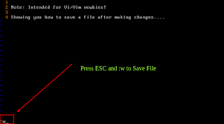
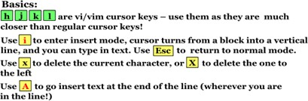
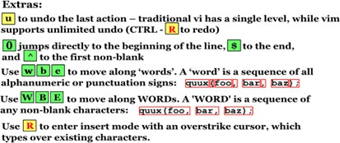
Getting Started
INTERNAL
Initial Screen when opening vi editor

Slide 35
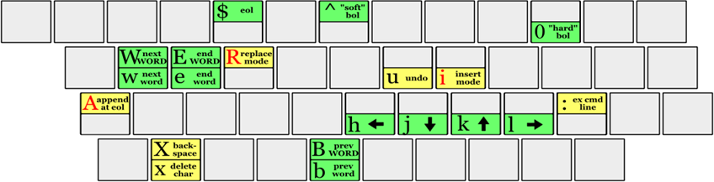
Ready Reckoner
INTERNAL
Keys | Use
:w | Save the file but keep it open
:q | Quit without saving
:wq | Save the file and quit
:q! | Force quit without saving the file
Keys | Use
k | Move cursor up
j | Move cursor down
h | Move cursor left
l | Move cursor right

Slide 36
Key Stroke Lists
INTERNAL
Keystrokes | Action
i | Insert at cursor (goes into insert mode)
a | Write after cursor (goes into insert mode)
A | Write at the end of line (goes into insert mode)
ESC | Terminate insert mode
u | Undo last change
U | Undo all changes to the entire line
o | Open a new line (goes into insert mode)
dd 3dd | Delete line Delete 3 lines.
D | Delete contents of line after the cursor
C | Delete contents of a line after the cursor and insert new text. Press ESC key to end insertion.
dw 4dw | Delete word Delete 4 words

Slide 37
Key Stroke Lists
INTERNAL
Keystrokes | Action
x | Delete character at the cursor
r | Replace character
R | Overwrite characters from cursor onward
s | Substitute one character under cursor continue to insert
S | Substitute entire line and begin to insert at the beginning of the line
~ | Change case of individual character
:/search | Search the file
:line no | Goto to line based on the line no
yy 3yy | Yank copies one line Copies 3 lines
P | Paste the copied lines

Slide 38
Class work : Lab 1
INTERNAL
Format the below text using vi editor into a better readable format .
A sample output is shown in next slide
vi is a screen-oriented text editor originally created for the Unix operating system. The original code for vi was written by Bill Joy in 1976.As the visual mode for a line editor called ex that Joy had written with Chuck Haley.The name "vi" is derived from the shortest unambiguous abbreviation for the ex command visual. Which switches the ex line editor to visual mode.In addition to various non– free software variants of vi distributed with proprietary implementations of Unix. vi was opensourced with OpenSolaris, and several free and open source software vi clones exist. Joy described 2.0 (vi) as a very large program, barely able to fit in the memory of a PDP-11/70.Although vi may be regarded as a small, lightweight, program today, it was not seen that way early in its history. By version 3.1, shipped with 3BSD in December 1979, the full version of vi was no longer able to fit in the memory of a PDP-11 . The editor would be also too big to run on PC/IX for the IBM PC in 1984.

Slide 39
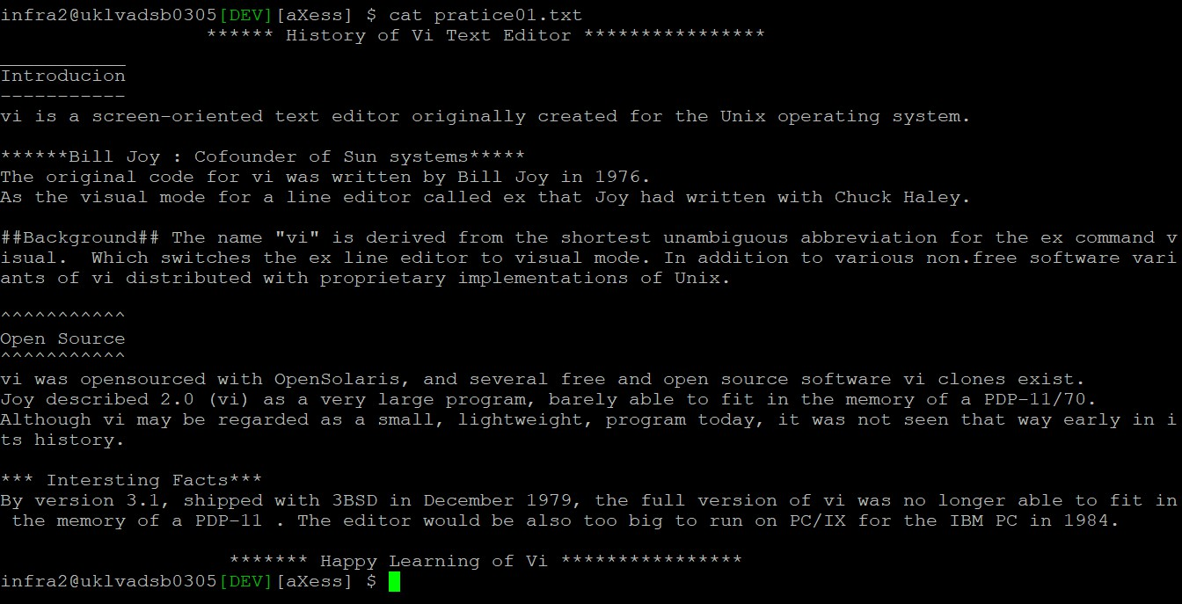
Class work : Lab 1 – Sample Formatted Text
INTERNAL

Slide 40
Shell Scripting
INTERNAL
What is a Shell ?
Shell is a scripting language
Takes Sequence of commands and execute them interactively
Store them in a file that can be invoked as a program
It can also be set to run as a background process
Acts as a interface to operating system
Shell Scripts can help to automate administrative tasks
Encapsulate complex configuration details
Get the full power of operating systems
Ability to combine and crate your own commands
Where It is used
Monitoring the system or server
Performance monitoring and troubleshooting
Create snapshots and data backups
Mange installations and service start / stop
Trapping error in system or application log files
User Management and tracking
System process management

Slide 41
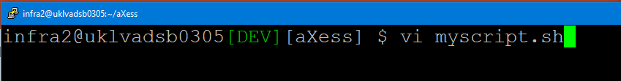
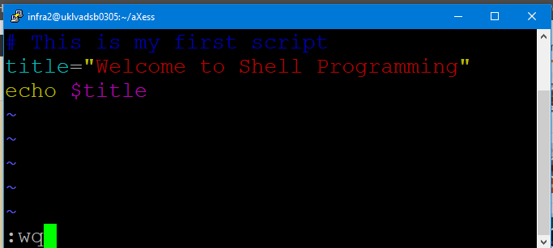
Lab Exercise – How to create Shell Script
INTERNAL
Step 1: Open a new file using vi editor
Step 2: Write commands

Slide 42
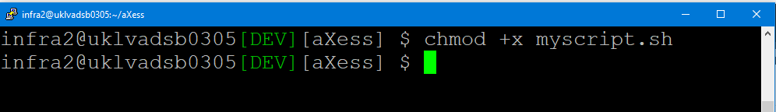
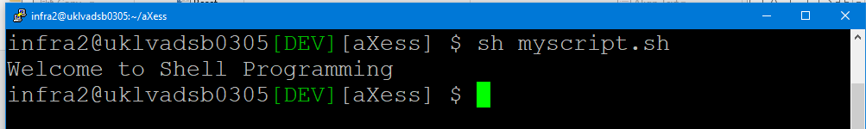
Lab Exercise – How to create Shell Script
INTERNAL
Step 3: Set it as a executable script
Step 4: Run the shell script

Slide 43
Variables
INTERNAL
Shell can contain two type of variables
System variables (In general Capital letters are used)
User defined variables (For example title=“hello world”)
Variables are case sensitive
Do not use space or special characters like * or ? or space
echo can be used to display the values in the variable
$ symbol must be prefixed when using the variables or printing the values (echo $title)

Slide 44
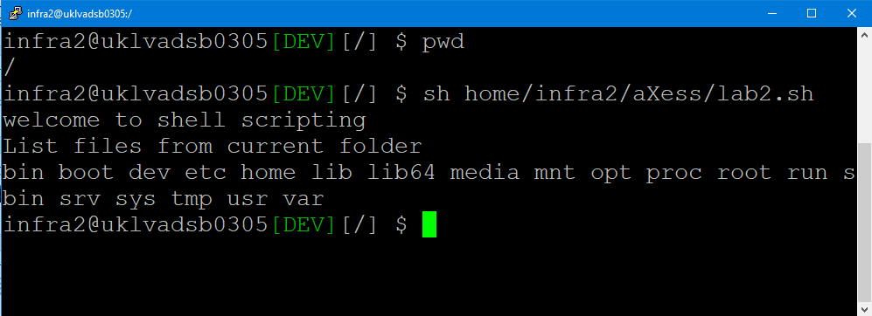
Lab2
INTERNAL
Problem Statement :
Create a Shell program that displays the files in the current folder
Add custom title and subtitle for the output
Execute this shell from any folder and see the output
Note : Expected output is shown below (from root folder)

Slide 45
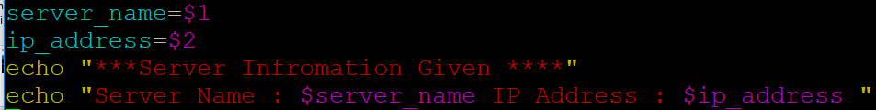
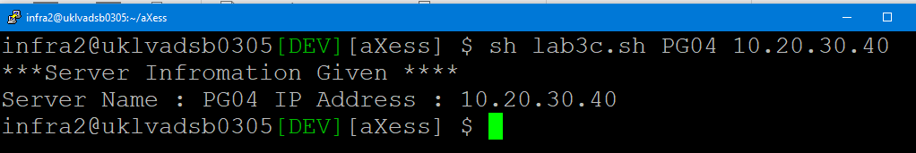

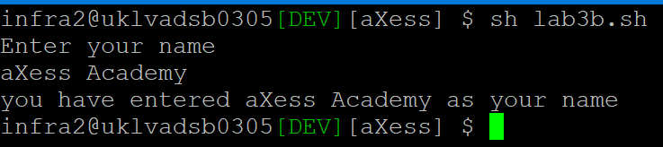
Interactive Shell
INTERNAL
Shell accept input from user in two forms
Interactive in terminal input using “read” statement :
Command line arguments ($0 , $1 , $2 …) represents each argument value

Slide 46
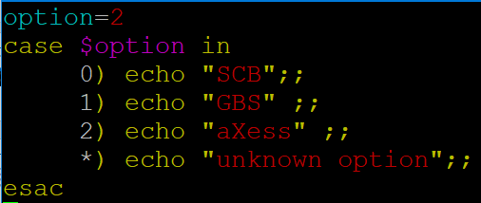
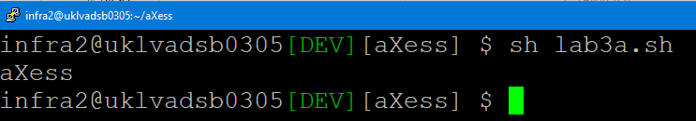
Branching logic – Case statement
INTERNAL
Shell script can contain switching or case statement
Syntax
Example
case $variable-name in pattern1) command
;;
pattern2) command
;;
……………………… pattern-N) command
;;
*) command ;; esac
Output

Slide 47
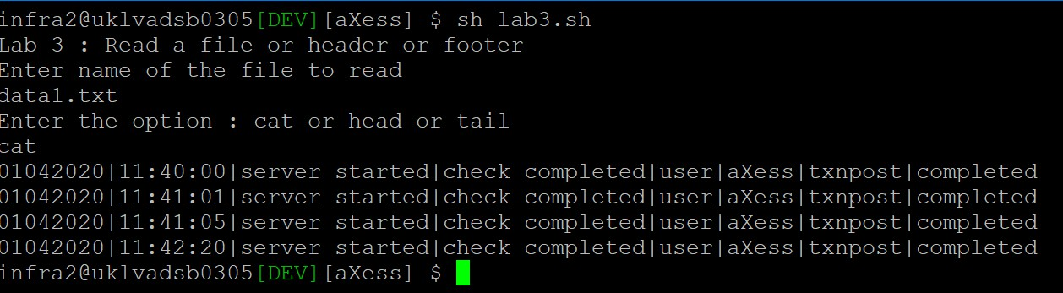
Class Work – Lab3
INTERNAL
Problem Statement :
Create a same data file or take an existing application or system log file
Create a Shell program that reads a file and display the content .
Create a shell program to display header content
Create a shell program to display the last part of the content
Merge all the above option into one shell script using “case” statement
Note : Expected output is shown below

Slide 48
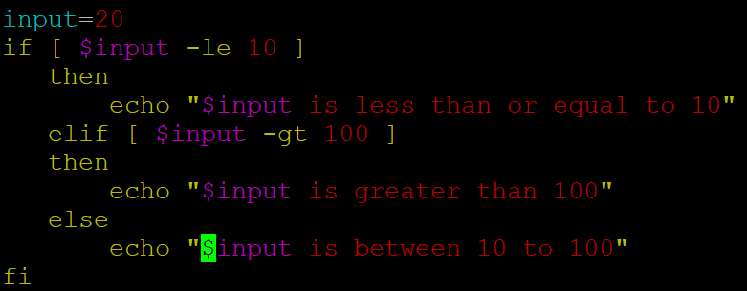
Branching logic – If statement
INTERNAL
Shell script can contain “if” statement to
check and branch logic
Mathematical Operators in shell
-eq | Is equal to | var –eq 10
-ne | Is not equal to | var –ne 200
-lt | Is less than | var –lt 10
-gt | Is greater than | var –gt 20
-le | Is less than or equal to | var –le 100
- ge | Is greater than or equal to | var –ge 20
Syntax
If condition then
execution of commands elif condition
then
execution of commands else
execution of commands
fi

Slide 49
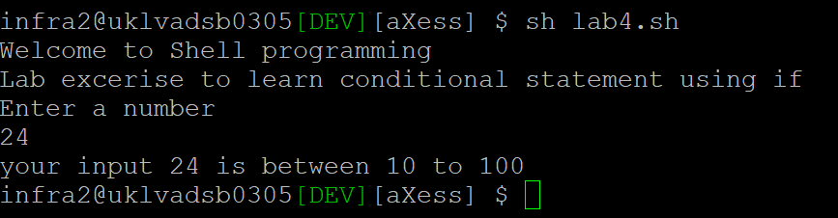
Class Work – Lab4
INTERNAL
Problem Statement :
Create a Shell program that read a number as input and checks for less than 10 or between 11 to 100 or more than 100
Prints the result in a text format
You can use “If-elif-fi” statement
Note : Expected output is shown below

Slide 50
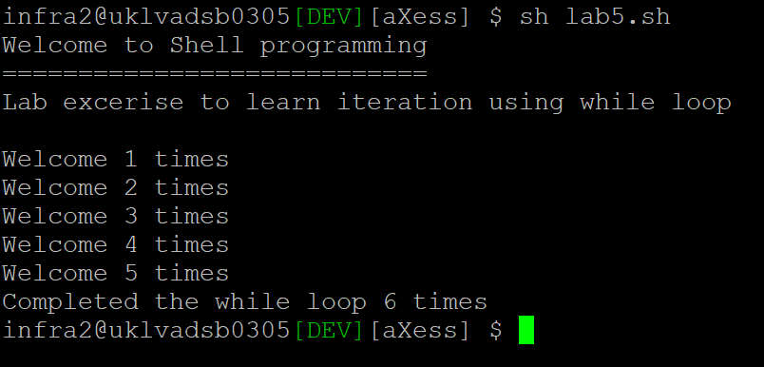
Class Work – Lab 5
INTERNAL
Problem Statement :
Create a Shell program that takes a number and iterates 5 times
Print a welcome text for each iteration
You can use “while” loop for practice
Note : Expected output is shown below

Slide 51
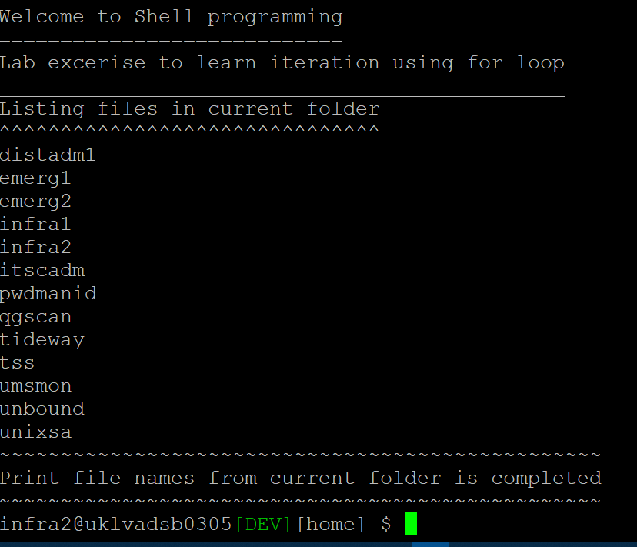
Class Work – Lab 6
INTERNAL
Problem Statement : Create a Shell program that extracts and print the file names from the current folder
Run that shell from any folder
Note : Expected output is shown here

Slide 52
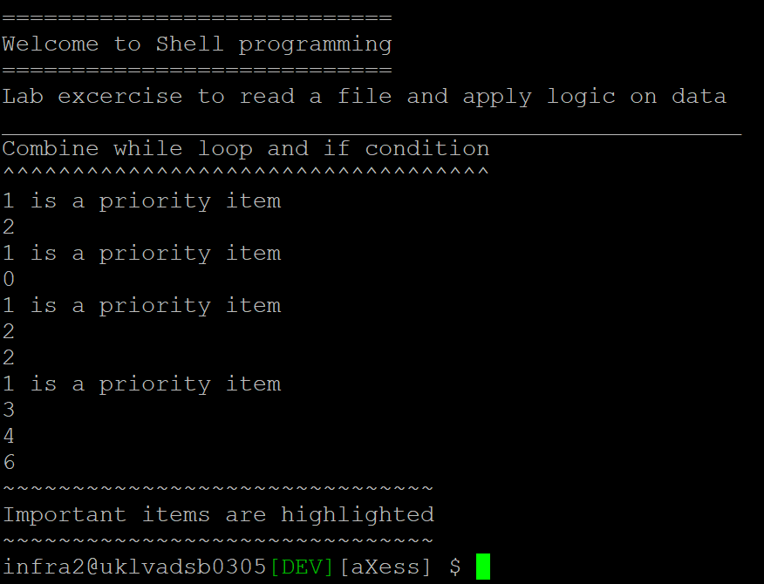

Class Work – Lab 7
INTERNAL
Problem Statement :
Create a data file with a number in each row
Create a Shell program that reads this data file and print a meaning full text based on data
Input

Slide 53
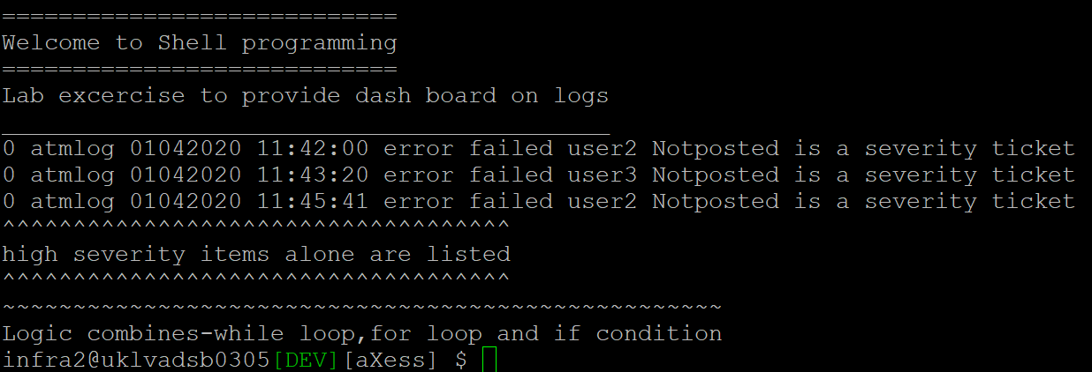
Class Work – Lab 8
INTERNAL
Problem Statement : Read this text file and print records that have exception with flag “0”
1 atmlog 01042020 11:40:00 started ok user1 txnposted
0 atmlog 01042020 11:42:00 error failed user2 Notposted
1 atmlog 01042020 11:42:02 started ok user3 txnposted
1 atmlog 01042020 11:42:05 started ok user1 txnposted
0 atmlog 01042020 11:43:20 error failed user3 Notposted
0 atmlog 01042020 11:45:41 error failed user2 Notposted
1 atmlog 01042020 11:46:00 started ok user4 txnposted
1 atmlog 01042020 11:48:00 started ok user1 txnposted
Document
Title

Slide 54
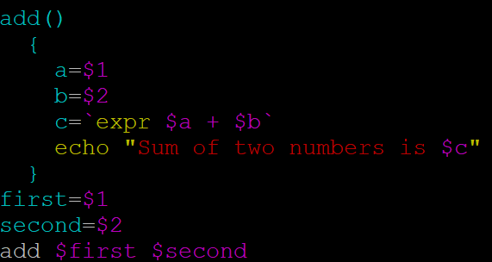
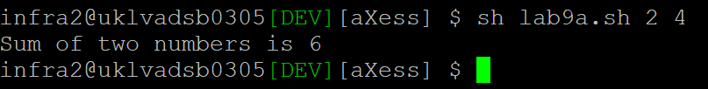
Functions
INTERNAL
A series of statements can be combined which can represent it as a callable function
Syntax - for
function-name ()
{
statements for execution
}

Slide 55
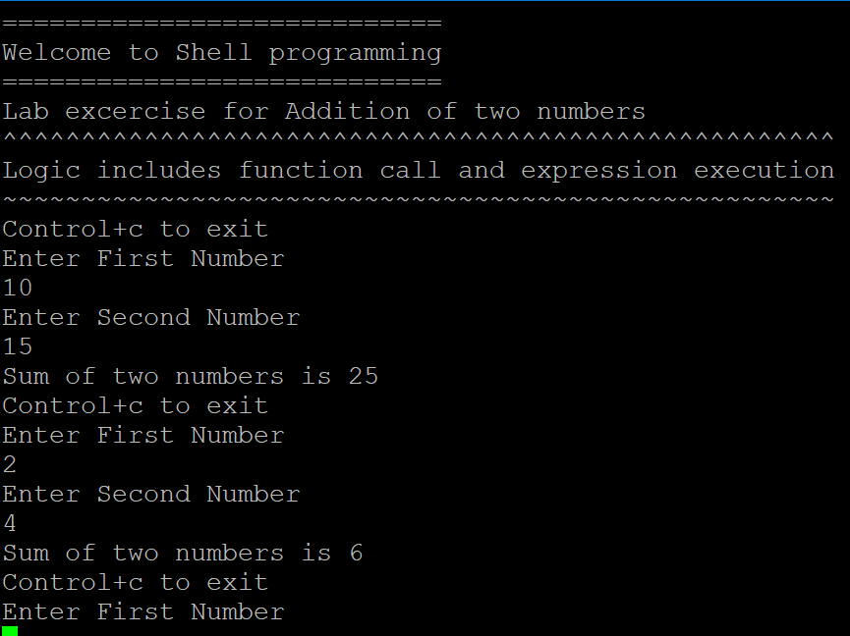
Class Work – Lab9
INTERNAL
Problem Statement : Create a Shell program that takes two numbers from user and print the sum of it

Slide 56
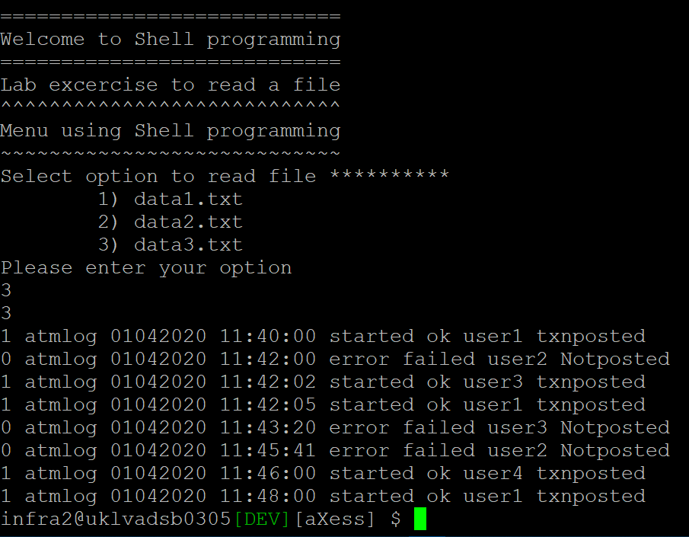
Class Work – Lab10
INTERNAL
Problem Statement :
Create a set of data files or log files
Create a Shell program that takes option from user on the file selection and display the content
Note :
Try to use the function , case statements , while and other syntax
Try to avoid menu or dialog as they may have a version or distribution specific

Slide 57
Module 5
Diagnostics And Monitoring
INTERNAL

Slide 58
The Prime responsibility of any operating system is to Manage the System Resources, namely,
INTERNAL
Objective
Processor (CPU)
Memory
Storage (Disk). and
Network

Slide 59
The Prime responsibility of any operating system is to Manage the System Resources, namely,
INTERNAL
Objective
Processor (CPU)
Memory
Storage (Disk). and
Network

Slide 60
Processor
INTERNAL
All Information is available in /proc
nproc: Number of processing units available
Number of processing units available to the current process, which may be less than the
number of online processors
Uptime: How long the system has been running
Gives current time, how long the system
has been running, how many users are currently logged on, and the system load averages for the past
1, 5, and 15 minutes.
$ ls /proc
$ nproc
$ uptime
`

Slide 61
Memory
INTERNAL
All Information is available in /proc
$ meminfo
Useful Options
-b bytes
-k kilobytes
Display amount of free and used memory in the system
free displays the total amount of free and used physical and swap memory in the system, as well as
-m Megabytes
-g gigabytes
-h human readable
-w wide
-t total
the buffers and caches used by the kernel
`
$ free

Slide 62
Storage
INTERNAL
Mount a file system
$ mount
Report file system disk space usage
$ df
df displays the amount of disk space available on
the file system containing each file name argument.
Estimate estimate file space usage
$ du
Summarize disk usage of each FILE, recursively for
directories.
Useful Options
-a all
-B Block-size
--direct show statistics of the file instead of mountpoint
--total produce grand totel
-h human readable
-i inodes
-l local
--no-sync do not invoke sync before getting usage info
-T print file system type

Slide 63
Network
INTERNAL
Show / manipulate routing, devices, policy
routing and tunnel
Useful Options
-h human readable
-b Read commands from provided file or standard
input and invoke them. First failure will cause
termination of ip.
-s stats Output more information
-l Specify maximum number of loops the 'ip
address flush' logic will attempt before giving up
-f pecifies the protocol family to use.
$ ip
Objects
link
addr
network device
protocol (IP or IPv6) address on a device.
addelabel label configuration for protocol address selection.
rule rule in routing policy database.
route routing table entry tunnel tunnel over IP. mroute multicast address.
monitor watch for netlink messages.
token manage tokenized interface identifiers.
-d details
-o oneline
-c use colour output

Slide 64
Network
INTERNAL
Print network connections, routing tables, interface statistics, masquerade connections, and multicast memberships
$ netstat
Address family options
-t --tcp
-u --udp
-S --sctp
-w --raw
-a --all
-n numeric
-W wide
-p program
Useful Options
-h human readable
-b Read commands from provided file or standard input and invoke them. First failure will cause
termination of ip.
-s stats Output more information
-l Specify maximum number of loops the 'ip address flush' logic will attempt before giving up
-f pecifies the protocol family to use.
-o oneline
-c use colour output
-d details
Document Title
64

Slide 65
Server Diagnostics tools
INTERNAL
Display Linux Process
Useful Options
-h help
-v version
-b Batch Operation
-d delay time in secs
-I idle process
-n number of iterations
-p monitors
-s secure Mode
-w output width overwrite
$ top
The top program provides a dynamic real-time view of a running system. It can display system summary information as well as a list of processes or threads
currently being managed by the Linux kernel. The types of system summary information shown and the types, order and size of information displayed for processes are all user configurable and that configuration can be made persistent
across restarts.

Slide 66
Server Diagnostics tools
INTERNAL
Collect, report, or save system activity
_{$ s}in_{a}f_{r}ormation.
Useful Options
-A reports all parameters
-B Reports paging statistics
-b Reports I/O rate and transfer statistics
-b Batch Operation
-d Report activity for each Block Device
-e Set the ending time of the report
-F Display the statistics of Current Mount FileSystems
-H Reports hugepages utilization Statistics
-I Select data records at seconds as close as possible to the number specified
-m report Power Management Statistics
-q report queue length and load averages
-r report Memory utilization
The sar command writes to standard output the contents of selected cumulative activity counters in the operating system.
The accounting system, based on the values in the count and interval parame‐
ters, writes information the specified number of times spaced at the specified intervals in seconds.

Slide 67
Server Diagnostics tools
INTERNAL
Report virtual memory statistics
$ vmstat
vmstat reports information about processes, memory, paging, block IO, traps, disks and cpu activity.
The first report produced gives averages since the last reboot. Additional reports give information on a sampling period of length delay. The process and memory reports are instantaneous in either case.
Useful Options
-a displayes active and inactive memory
-m displays slab information
-n displays header only once rather than
periodically
-s Displays a table of various event counters and memory statistics
-d Report disk statistics
-p Detailed statistics about partition
-t Append timestamp to each line

Slide 68
Server Diagnostics tools
INTERNAL
Report Central Processing Unit (CPU) statistics and
input/output statistics for devices and
partitions.
$ iostat
The iostat command is used for monitoring system input/output device loading by observing the time the devices are active in relation to their average transfer rates.
The iostat command generates
reports that can be used to change system configuration to better balance the input/output load
between physical disks.
Useful Options
-c displays CPU utilization
-d displays device utilization
-h human readable device utilization
-p displays statistics for block devices and all their partitions
-t Print the time for each report displayed.
-x displays extended statistics

Slide 69
Module 6
Packages and Installation
INTERNAL

Slide 70
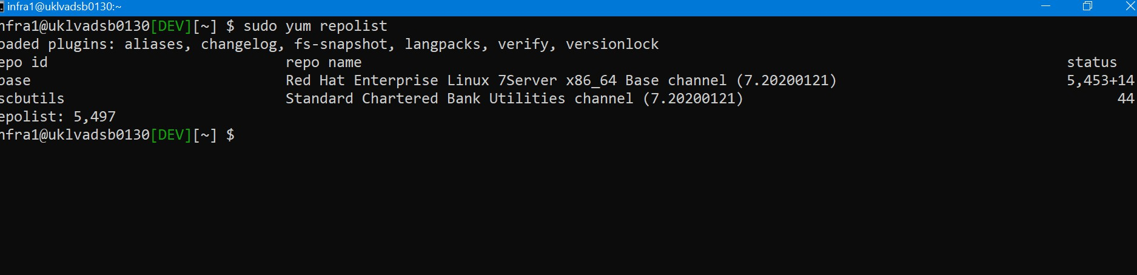
Software packages
INTERNAL
Packages are compressed archive of all the files related to a particular software
They can contain OS instructions as well as dependencies on other packages
Common type of linux packages are – rpm, deb, tgz etc.
Most linux distributions have package managers to install , update and delete packages , for example RedHat has yum, Debian has apt etc
Each package manager understands a specific format of packages – for example yum understands rpm etc.
Package manager “pulls” the relevant packages from a central repository
Configured Repositories can be listed using the command
$ sudo yum repolist

Slide 71
Software packages
INTERNAL
Packages are compressed archive of all the files related to a particular software
They can contain OS instructions as well as dependencies on other packages
Common type of linux packages are – rpm, deb, tgz etc.
Most linux distributions have package managers to install , update and delete packages , for example RedHat has yum, Debian has apt etc
Each package manager understands a specific format of packages – for example yum understands rpm etc.
Package manager “pulls” the relevant packages from a central repository
Configured Repositories can be listed using the command
$ sudo yum repolist

Slide 72
Installing package
INTERNAL
Using yum
Command Syntax
- yum <options> <commands>
Some common commands
To get help
$ sudo yum --help
List installed packages
$ sudo yum
T
installed
To update all repositories
$ sudo yum update
To install software
$ sudo yum emacs
To remove a package
$ sudo yum remove emacs

Slide 73
Using rpm
INTERNAL
RPM is another tool for managing packages in Red Hat
Rpm allows multiple versions of the software to be installed.
The relevant package needs to be downloaded first and then installed
To install a package
$ sudo rpm –i jdk-8u161-linux- x64.rpm
To update a package
•
$ sudo rpm –U
Note : To download we can use tools like wget
wget https://<url>/ ....

Slide 74
Installing tar.gz
INTERNAL
Installation of .tar.gz files is fully manual activity requiring configuration setup.
The tar.gz files needs to be extracted and then configured for installation
Steps to install docker package in testbox
$ tar zxvf docker-18.09.1.tgz
$ sudo cp docker/* /usr/bin/
$ sudo dockerd &

Slide 75

Thank You
INTERNAL

